Slide 1
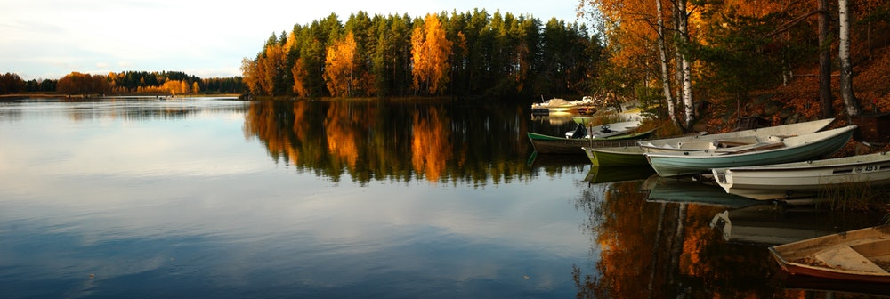

Floating a new business course: Developing market segments for Creek Boats
Andrew Wise, AZIZ Malik , Karthik Subramanian, and Mark Preston
November 2017

Slide 2

Market segmentation for Creek Boats
Creek Boats Market Segments
What can you expect?
Introducing the Business Case
Analytics Problem and Scoping
Goals of the Analysis
Data Review
Market Segment Development
Recommendations and Next Steps

Slide 3
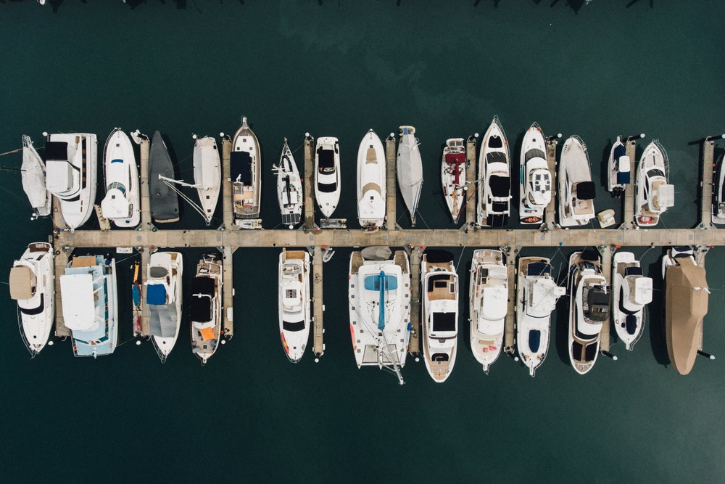
Project Scope
Creek Boats Market Segments
Project conducted on behalf of Creek Boats
Working for Customer Insights group at multi-use boat company
Company suffering through general decline in boat industry
To combat general decline, company needs data-driven growth strategy
Strategy focuses on expanding market in North America
As part of this expansion, Creek interested in understanding North America customer base
Focus on building more targeted boats for new market entry

Slide 4

Analysis Goals
Creek Boats Market Segments
What are we trying to accomplish?
Complete dimensional reduction on extensive survey data
Conduct an initial factor analysis on participant’s motivation responses
Develop defined market segments to better understand boat customers
Suggest North American market sizing and identify suitable launch locations
Offer sound next steps to further the analysis during client hand-off

Slide 5

Focus on the boating data
Creek Boats Market Segments
What does the working set contain?
The data were collected by a market research company for Creek
Each row represents a single survey response
A total of 2,813 respondents were available for analysis with 54 columns
Data not appropriate for product development using conjoint
Survey participants answered questions on attitudes, purchase behavior, and demographics

Slide 6
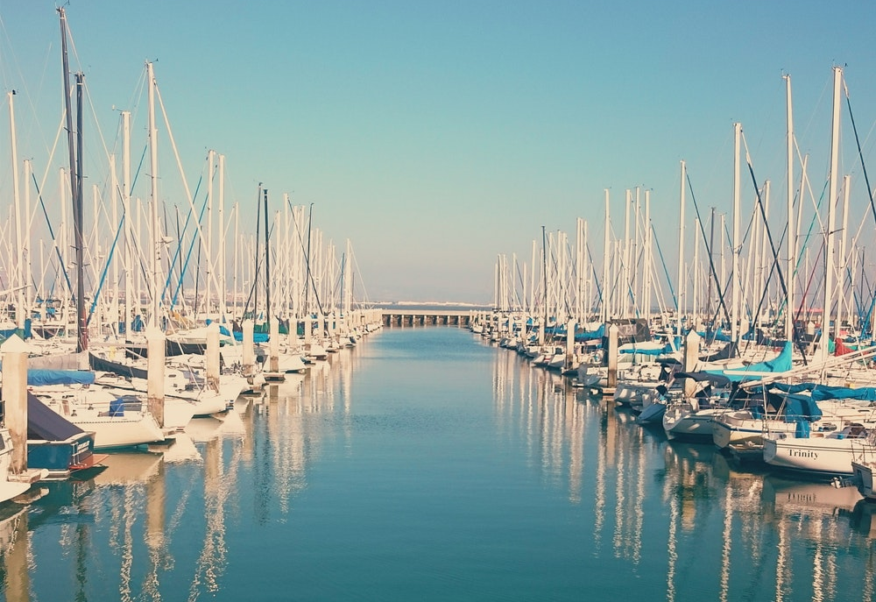
PCA: Exploring customer needs and reducing dimensions
Creek Boats Market Segments
How did we pare down the initial data?
Set included 29 Motivation and needs questions
To reduce variance and complete dimensional reduction, PCA was used
Factor loadings analyzed to name principle components
Factors scores carried forward for customer segmentation work

Slide 7
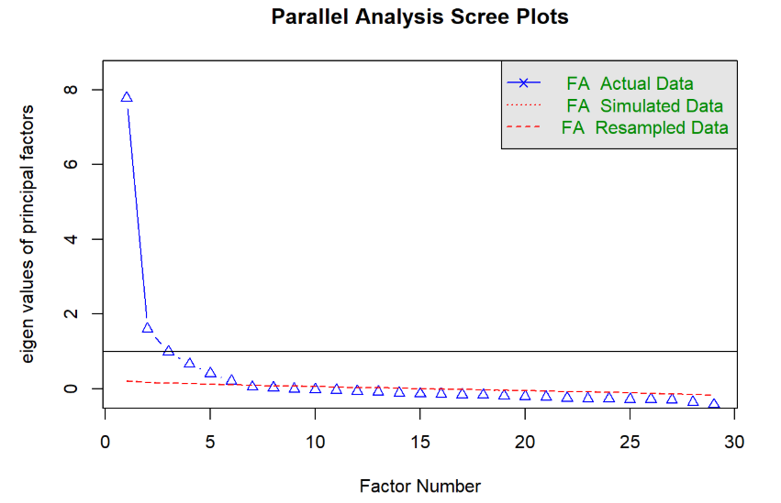
PCA Results
Creek Boats Market Segments
Variance Account For (VAF) elbow at 6 components
Provides 95% variance explanation at that level
29 questions expressed as 6 high level fields when done:
Feel Good Factor
Price Conscious
Boat Experts
Brand Conscious
Passionate Boaters

Slide 8
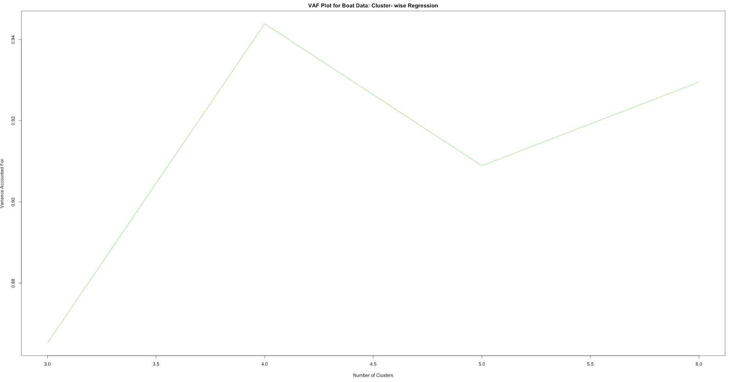
Customer Segmentation Approach #1
Creek Boats Market Segments
How did we define customer segments?
Clusterwise regression on purchase behavior and demographic questions
Response: how likely are you to buy a new boat in the future?
Predictors:
Purchase behavior examples: What activities do like to do while boating, who joins you while boating
Demographic examples: income, marital status, age, employment
Results: five and six cluster solution chosen due to stable r squared within clusters

Slide 9
Customer Segmentation Approach #1- Results
Creek Boats Market Segments
What do the boat segments look like?
Cluster size stable between train and test and good R squared
But, these clusters are not clearly interpretable as contradictions appear within clusters
Example: clusters that indicate that people like to both boat alone, and with friends while socializing
Not all are bad, but these clusters leave something to be desired. Cluster size stable between train and test and good R squared
Cluster Sizes
Five Clusters
Train |  | 19.47% | 47.33% | 12.21% | 10.02% | 10.97%
Test |  | 22.10% | 46.81% | 9.85% | 10.14% | 11.10%
Six Clusters
Train | 8.55% | 14.46% | 12.21% | 14.74% | 33.99% | 16.04%
Test | 7.24% | 13.22% | 8.69% | 10.62% | 46.33% | 13.90%

Slide 10

Customer Segmentation Approach #2
Creek Boats Market Segments
How did we define customer segments?
Utilized K-Prototypes clustering
Combines numeric variables and demographic responses in same clustering result
Further builds on initial PCA work- factor scores included for customer needs information
Features incorporated - Gender, income, paid for current boat, who you boat with, activities performed while boating, brand loyalty, brand advocacy
Used scree plot, observation spread and interpretation to determine optimal number of clusters

Slide 11
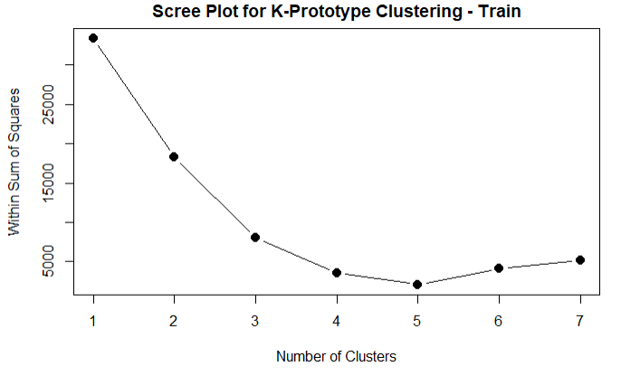
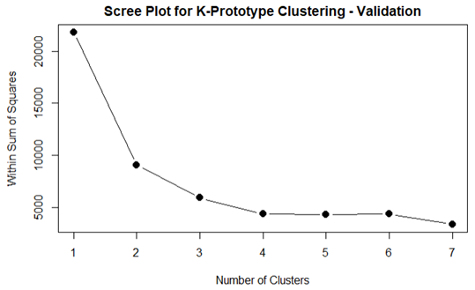
Customer Segmentation Approach #2- Results
Creek Boats Market Segments
What do the boat segments look like?
Profile 1: High net worth enthusiasts
Heavy boat users who have income between $100,000 and $125,000 and are brand advocates and brand loyal. They are definitely going to make future boat purchase. They have medium purchase behavior and are particular about feel good factors. They are not boat experts, but are passionate boat riders and are price insensitive. They boat with their spouse and kids, and perform fishing, swimming, cruising, water sport, and socializing. The have paid between $30,000 and $50,000 for their current boat.
Profile 2: Middle class family fisherman
Medium boat users who have income between $60,000 and $75,000 and may make a future boat purchase. They are brand advocates and brand loyal. They have low purchase behavior, and have zero feel good factors. Moreover, they are neither boat experts nor passionate boat riders, and are price sensitive. They prefer to boat with their spouse and do fishing. They have paid between $10,000 and $20,000 for their current boat.
Profile 3: On the fence high net worth
Medium boat users who have income between $100,000 and $125,000 and may make a future boat purchase. They are not brand advocates and brand loyal. Further, they have low purchase behavior, and have zero feel good factors. Moreover, they are neither boat experts nor passionate boat riders, and are price sensitive. They prefer to boat with their spouse for cruising. The have paid between $20,000 and $30,000 for their current boat.

Slide 12

Actioning the Segments: Business Expansion Strategy
Creek Boats Market Segments
How did we suggest the clusters be deployed?
Demographic components from clusters can be used to identify suitable expansion locations for Creek
Cluster 1 and 3 shows customers tend to be high net worth families
Acquired US Census data to scope market size and ideal sites for launching boat business
Creek strategy calls for North American expansion- Limiting analysis to USA here

Slide 13
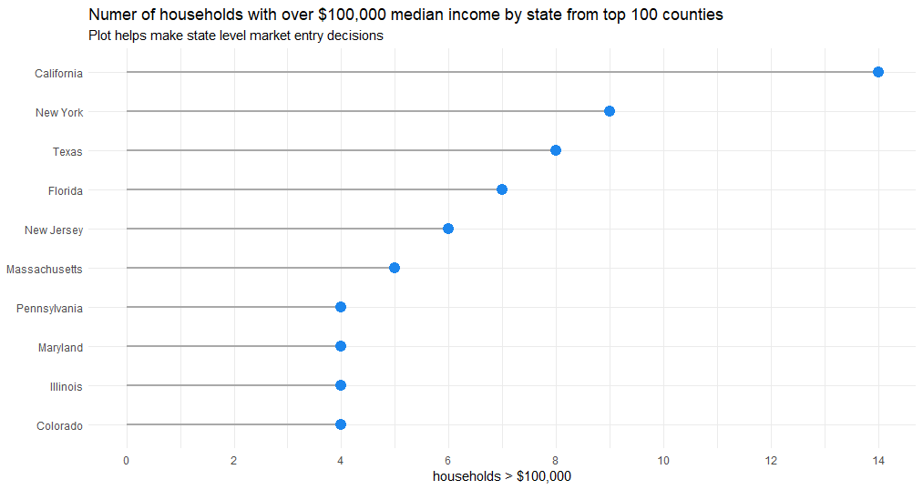
Identifying high net worth families in US States
Creek Boats Market Segments
What does the market size look like for boats?
Around 9 million households with $100,000 income
Filtered top 100 counties by count of over $100K households
Top 10 states listed: California, New York, Texas, and Florida seem like good candidates
Represent geographic regions in US (North, South, West, East)

Slide 14
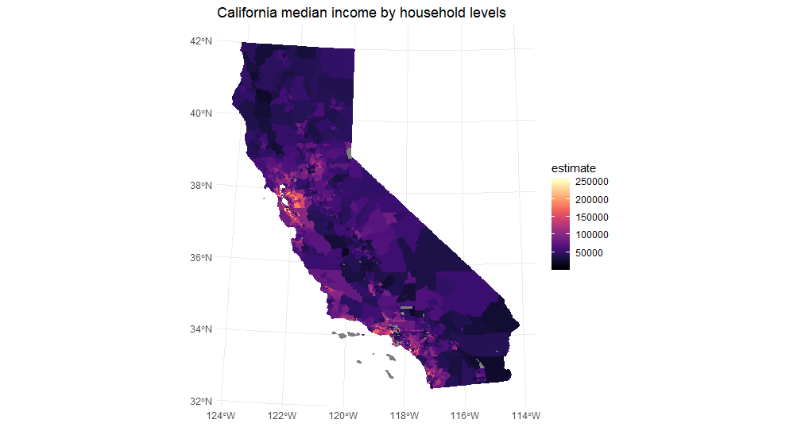
Mapping households over $100,000 in California
Creek Boats Market Segments
California shows large concentration of high net worth individuals
State has close proximity to ocean and is known for outdoor activities and tourism
As such, this is a very attractive area for Creek

Slide 15
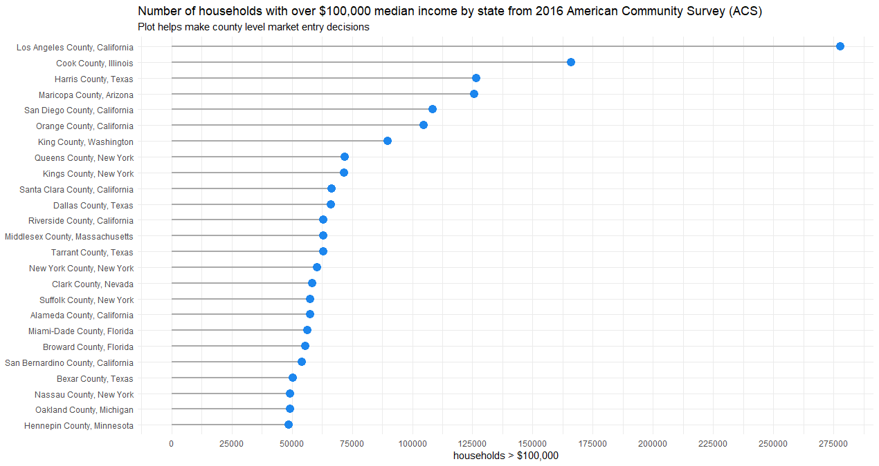
Location matters: Assessing attractive counties
Creek Boats Market Segments

Slide 16
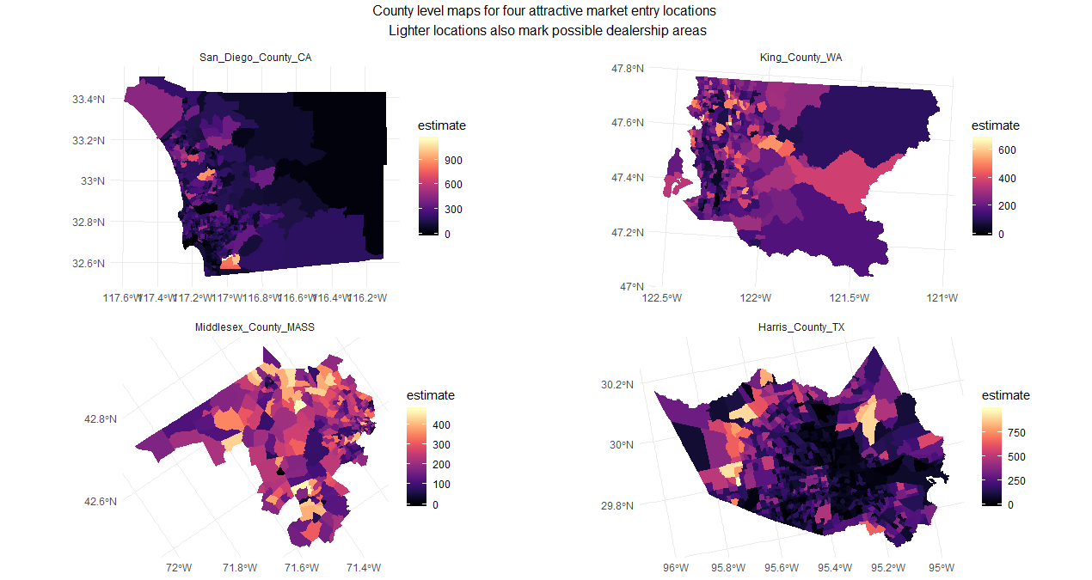
Mapping county level households over $100,000
Creek Boats Market Segments

Slide 17

Recommendations and Next Steps
How can this project move forward?
Formulate full expansion plan using results
Need to define expansion scope: How many regions, states, and counties? Suggesting California, NY, Texas, and Florida
Develop marketing plan and cost local market channels with clusters in mind
Focus on high net worth enthusiasts and on the fence high net worth clusters from K-Prototypes
Identify dealership start-up costs and assess local real estate prices for select counties
Create comprehensive consumer database on possible customers fitting segment profiles
Initial business case mentions Creek wants product design- Conduct new survey to facilitate conjoint analysis (showing full products)

Slide 18


